Slide 1

Digit Recognition Using Neural Networks
Presented By
K Chaitra Latha

Slide 2
Introduction
This presentation explores neural networks and how they classify handwritten digits.
The goal is to recognize digits despite variations in handwriting.
Objective
Design a system that uses neural networks to classify handwritten digits.

Slide 3

Methodology
Preprocessing
Building
Normalize pixel values and flatten images.
Design and train a neural network.
Evaluating
Measure accuracy and loss on test data.

Slide 4
Data Preprocessing
Normalization
Flattening
Splitting
Scale pixel values to range [0, 1].
Convert 28×28 images to 784-dimensional vectors.
Divide data into training and testing sets.

Slide 5



Neural Network Architecture
Input Layer
1
Flattened 784 nodes.
Hidden Layer
2
100 nodes, ReLU(Rectified Linear Unit) activation.
Output Layer
3
10 nodes, one for each digit.

Slide 6
Training the Model
Simple Model
Improved Model
5 epochs, 92.6% accuracy.
10 epochs, 97.7% accuracy.

Slide 7

Comparison of paper and Implemented

Slide 8
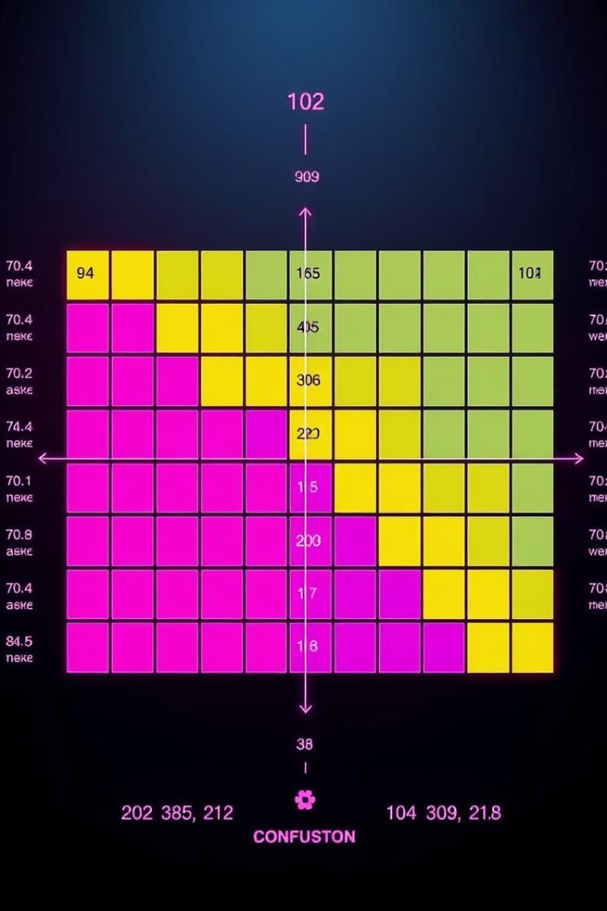


Results
Accuracy
Confusion Matrix
Plot comparing training and validation accuracy.
Visualization of true vs. predicted values.

Slide 9
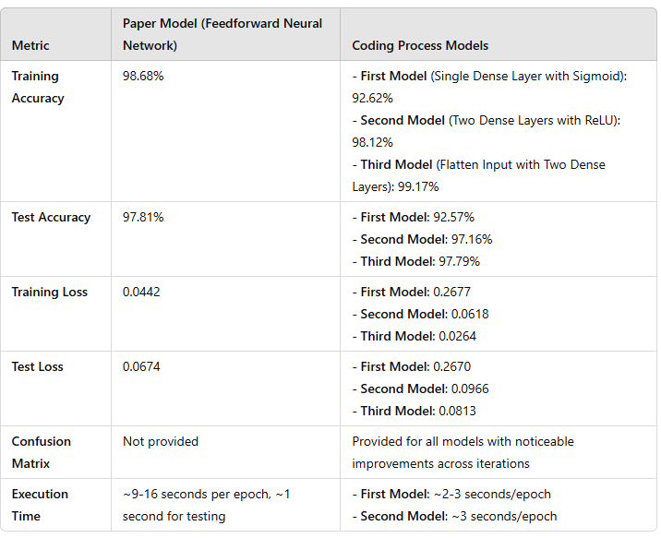

Slide 10

Key Insights
1
Hidden Layers
2
ReLU(Rectified Linear Unit)
Improved model performance.
Enhanced learning capability.
3
Optimizer & Loss
Critical for convergence.

Slide 11
Key Observations
Training Accuracy: The Flatten Input with Two Dense Layers from the coding process closely matches the paper’s result of 98.68%.
Test Accuracy: The Flatten Input with Two Dense Layers achieves a test accuracy of 97.79%, which is close to the paper’s 97.81%.
Loss: The coding process models show consistent improvements in both training and test loss, with the Flatten Input with Two Dense Layers model achieving comparable results to the paper.
Execution Time: The coding process models train faster than the paper's implementation, likely due to differences in architecture or computational resources.

Slide 12
Conclusion
The exploration of neural networks for digit recognition highlights their capability to effectively classify handwritten
digits, even with variations in handwriting. Through careful preprocessing, architecture design, and training
optimization, we achieved significant accuracy improvements
Key takeaways include:
The importance of data normalization and splitting for model performance.
The impact of hidden layers and activation functions, such as ReLU, on enhancing learning efficiency.
The critical role of optimizers and loss functions in achieving convergence and accuracy.

Slide 13


